Slide 1
Load Signature Study for Home Energy Management
Young Min Kim, Kelvin Liang
Advisor: Prof. G.P. Li, Dr. Arthur Zhang

Slide 2
What is an EMS?
Central hub for monitoring plug load devices used in the house.
Monitoring
Power Consumption
Cost
User behavior
Opportunities for energy management
On/Off relay control

Slide 3
Smarter Technology
Current systems
Modules for every plug load device
100% User Interaction
Load Signature allows for:
Automatic Identification
Using existing infrastructure (electrical panel)

Slide 4
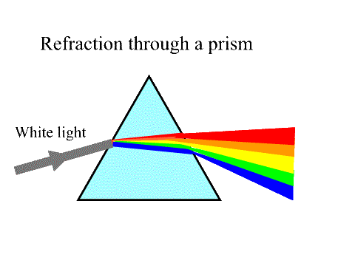

Load Signatures
Current Waveform
Active & Reactive Power
Harmonics
Operating Behaviors
Instantaneous Power Waveform
Instantaneous Admittance Waveform

Slide 5
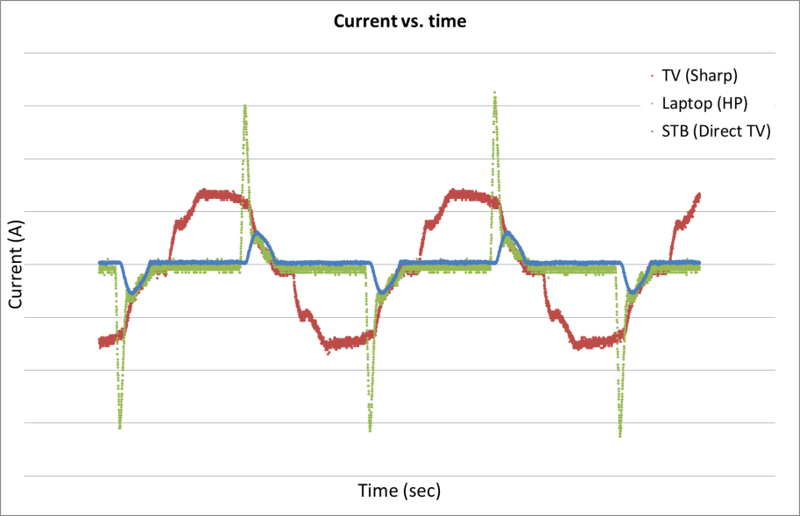
Current Waveform

Slide 6
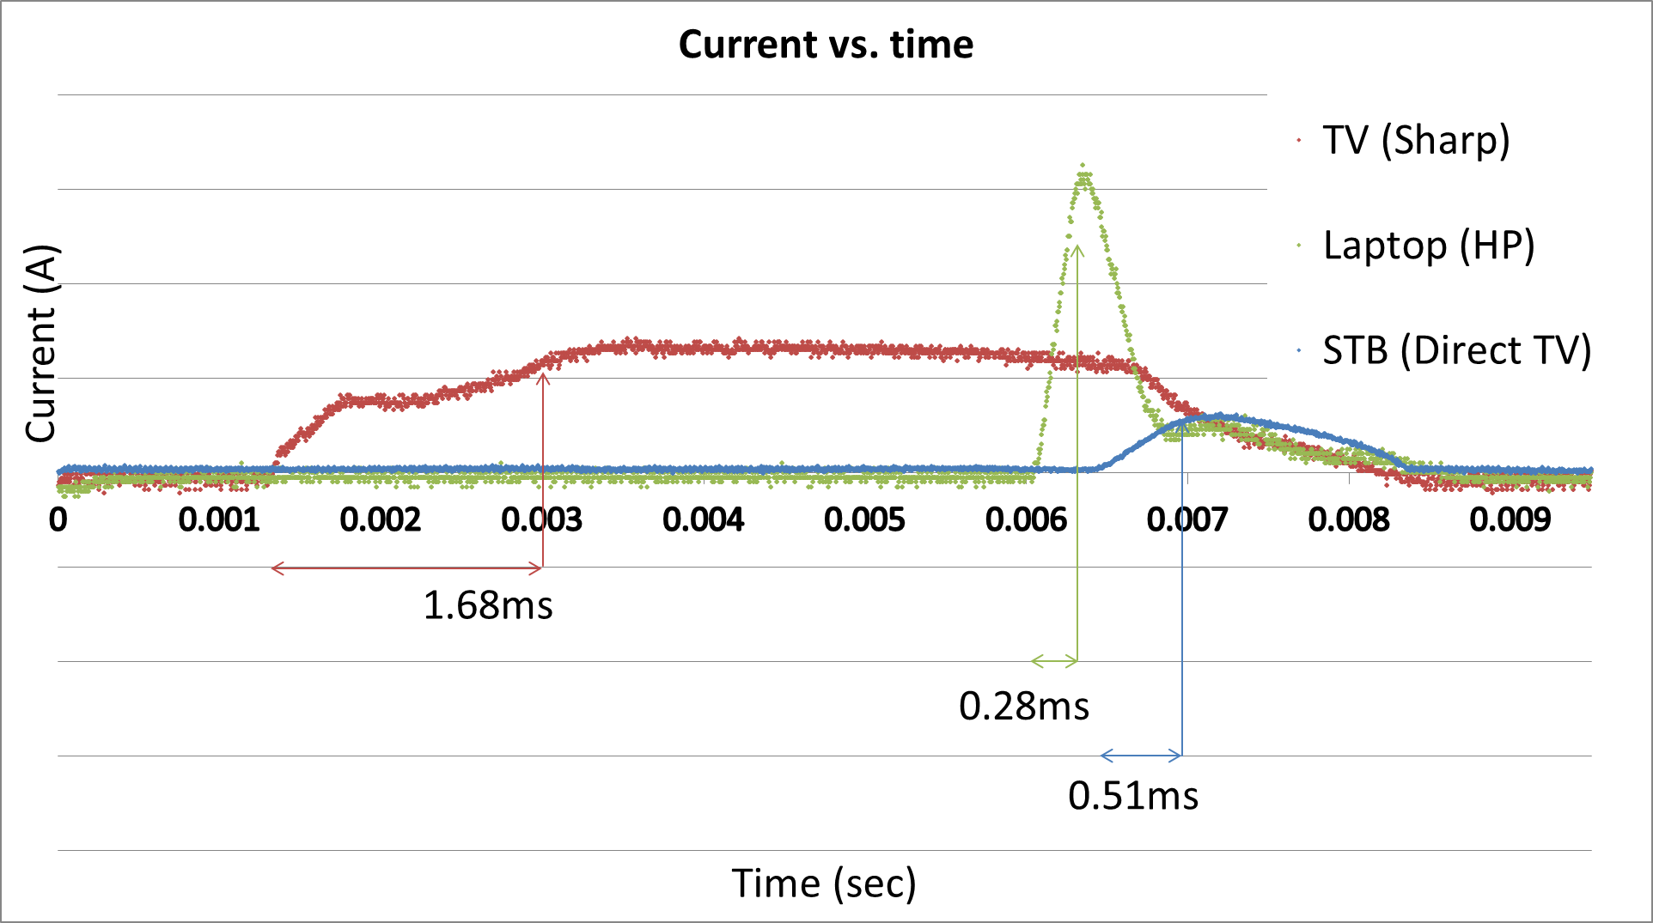
Current Rise-Up Time

Slide 7
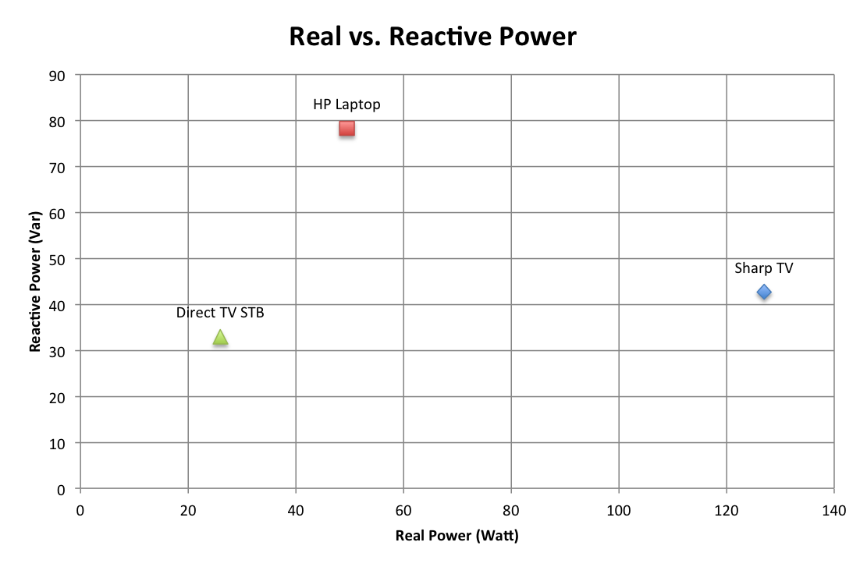
Active & Reactive Power

Slide 8
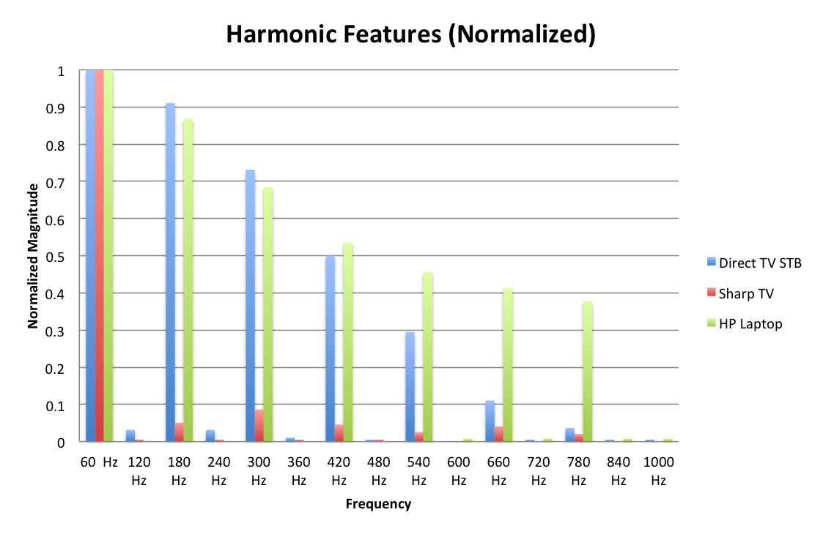
Harmonics

Slide 9
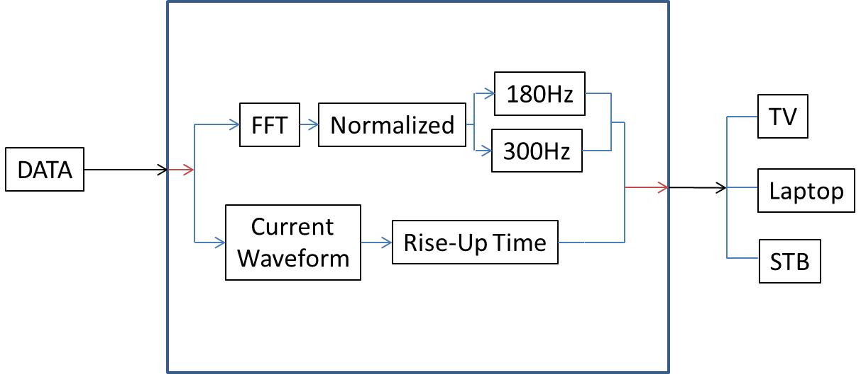
Current Algorithm Design

Slide 10
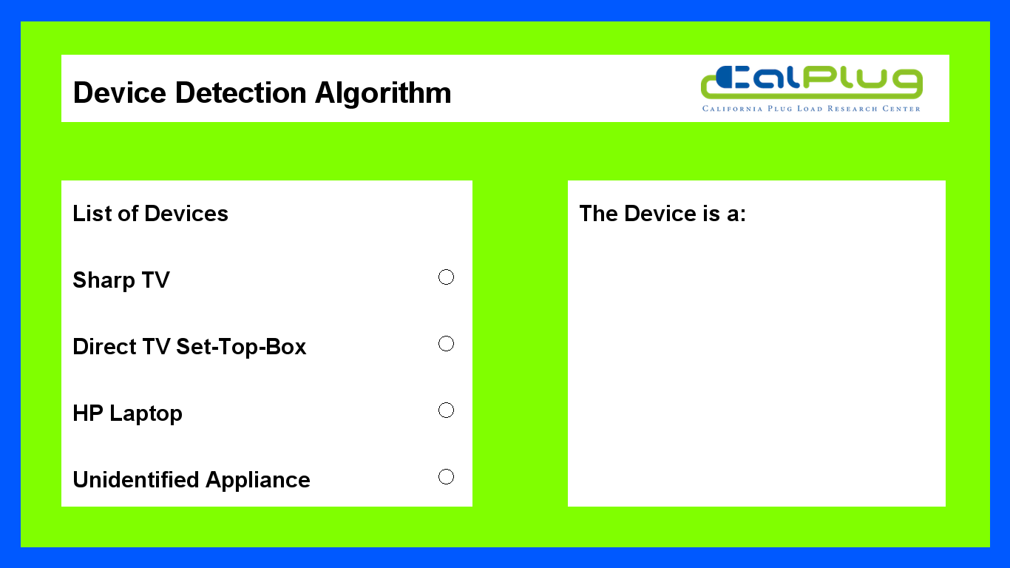

Slide 11
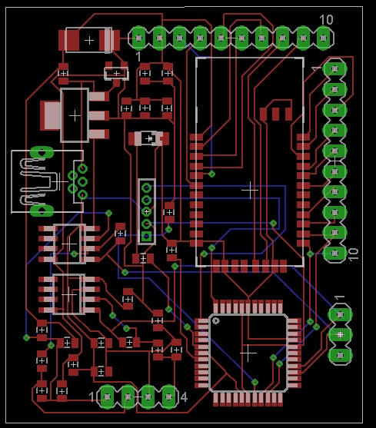
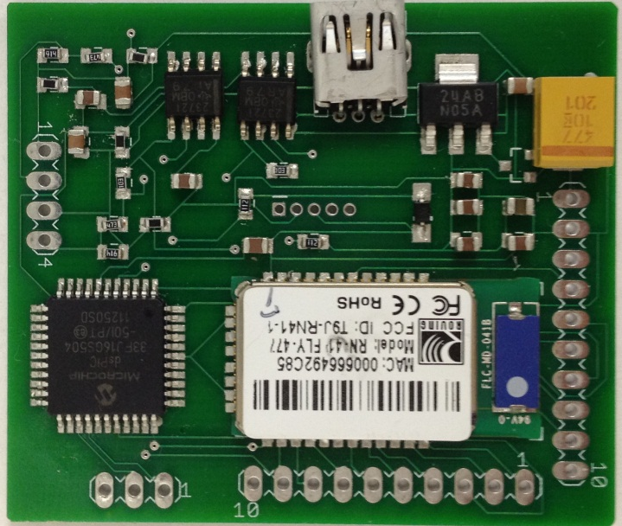
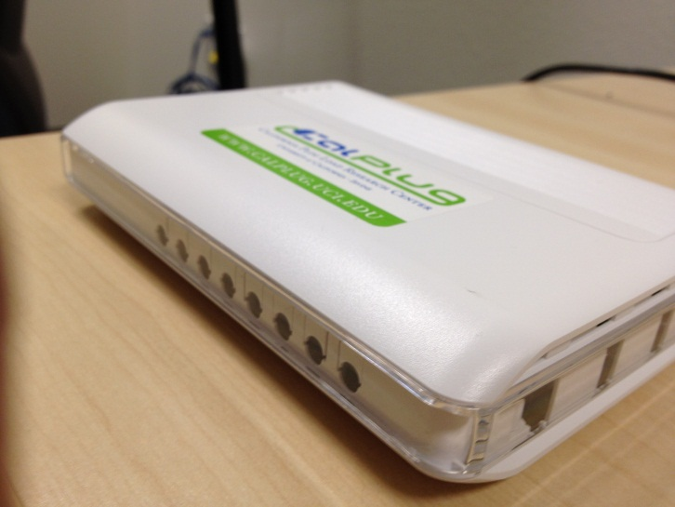
System Integration

